Slide 1
TOURISM
RECOMMENDATION
SYSTEM
PRESENTATION BY : 202IT009 | Kodingari Rajasekhar (M.Tech)
203IT001 | Shankaranarayan N (M.Tech Research IT)
202IT028 | Sibangkar basumatary (M.Tech)
202IT030 | Tushar (M.Tech)
IT700 | Project Presentation 1 | 18 Dec 2020

Slide 2
Content
Introduction | Abstract -- Sibangkar basumatary
Workflow | Inputs and Algorithms used --Tushar
What is Fuzzy Logic ? -- Shankaranarayan N
Mamdani Logic -- Kodingari Rajasekhar
Route recommendation | Scope -- Tushar

Slide 3
Introduction
TOURISM GENERATED ₹16.91 LAKH CRORE (US$240 BILLION)
OR
9.2% OF INDIA'S GDP (2018)
IT SUPPORTS 42.673 MILLION JOBS
(I.E) 8.1% OF ITS TOTAL EMPLOYMENT.

Slide 4
Can we make more money ?
“People simply don’t know”
We can generate even more money, if visitors can take well informed decisions
And this is where recommendation systems come into play

Slide 5
Abstract
Tourism is one of the industry in India with really high profit potential. India is well known for tourism. Every region in India specializes in a specific type of tourism. For example, Kerala is widely known for it’s natural tourism while Karnataka and Tamil Nadu are mostly known for it’s Temple and Historic tourism. Similarly every state/region in India is specializes in a specific kind of tourism.
In this mini-project we consider the North Eastern region of the country which is know for Nature tourism as test case. According to a 2015 survey on “Most Visited States of India by Foreign Tourists” non of the north eastern states are in Top 10. Despite it’s enormous natural gifts, the north eastern tourism generates less revenue and attracts less non-domestic tourists.
The main reason for this issue is that, foreigners have little to no idea when it comes to planning their trip through a less explored region. Thus to be able to make it easier for the tourists to know about the tourism sights in North East and in turn increase the tourism revenue, we need a system that is able to provide information on tourist attractions to tourists precisely in accordance with what the tourists want.
The proposed system uses the Fuzzy Logic method and Floyd Warshall Algorithm which are combined, so as to obtain results in the form of recommendations for tourist attractions based on the costs the tourist is willing to spend, the amount of time he/she is willing to spend and the distance he/she is willing to travel.

Slide 6
Workflow
FINDS
SHORTEST PATH
INPUTS
FUZZY LOGIC
OBJECTS
Fuzzification
Recommendations
OUTPUT
Shortest
Path Algorithm
Distance

Slide 7
Inputs and Algorithms used
INPUT
FUZZIFICATION
RECOMMENDATION OBJECTS
SHORTEST PATH
ROUTE RECOMENDATION
Input 1 : Cost
Input 2 : Time
Input 3 : Distance
Fuzzification : Mamdani Fuzzy Logic
Shortest Path : Floyd Warshall Algorithm

Slide 8
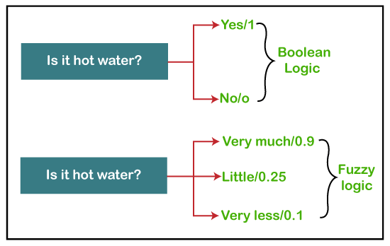
What is Fuzzy Logic ?
“Is the tea hot ?” | “Is the water warm ?” | “Is the juice cold ?”
BUT HOW MUCH IS HOT/WARM/COLD
TRADITIONAL SYSTEM
FUZZY SYSTEM

Slide 9

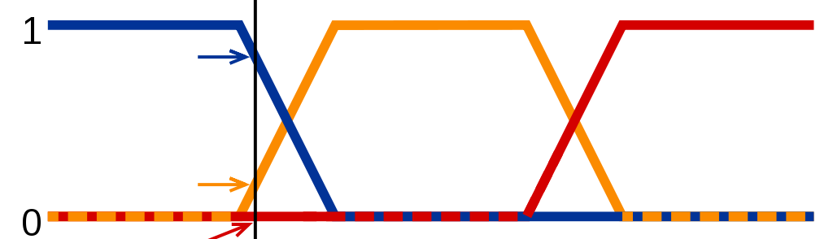
Fuzzy Logic – Automatic Breaking System
RANGE
CLOSE
0
FAR
1
IF CLOSE APPLY BREAK
CLOSE [0] | PRETTY CLOSE [0.3] | KINDA FAR[0.7] | FAR AWAY[1]

Slide 10
Mamdani Fuzzy Model
Crisp
Value
Fuzzy i/p
Value
Fuzzy o/p
Value
Crisp o/p
Value
Fuzzifier
Inference
Defuzzifier
Fuzzy
Knowledge
Base

Slide 11
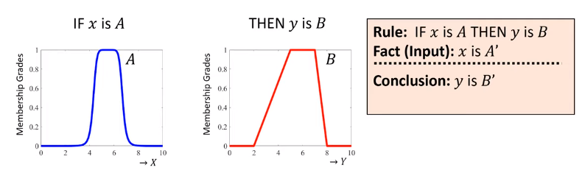
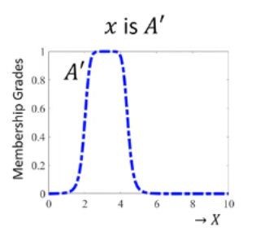
So, what is happening ?
SUPER IMPOSE

Slide 12
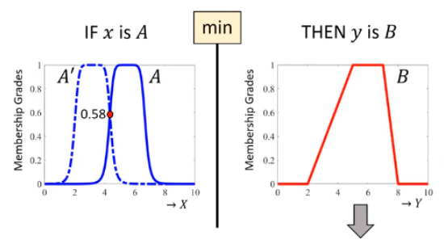
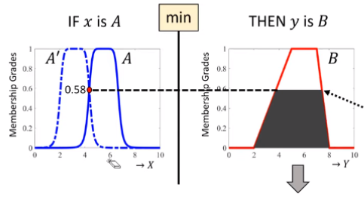
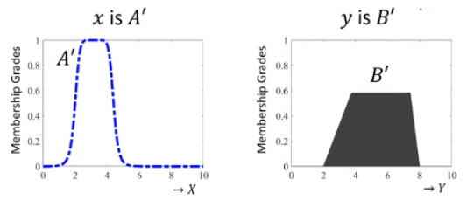
So, what is happening ?
W=0.58

Slide 13
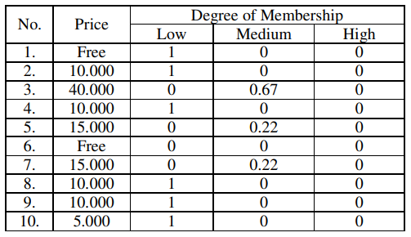
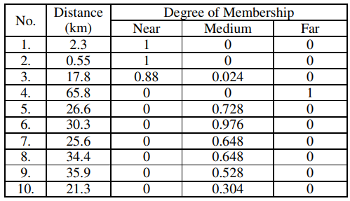
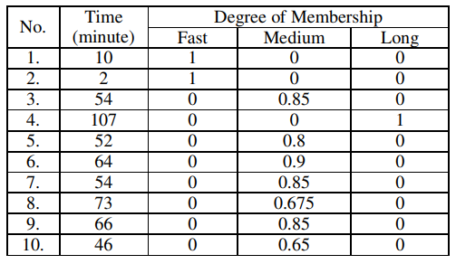
Degree of Memberships based on rules

Slide 14

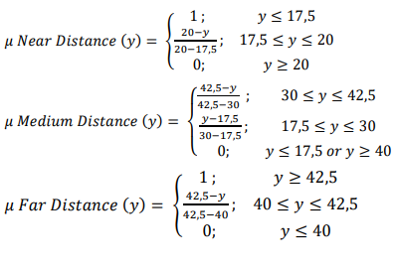
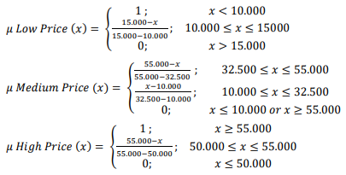
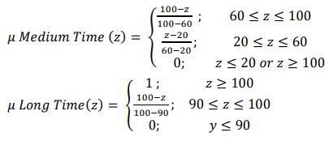
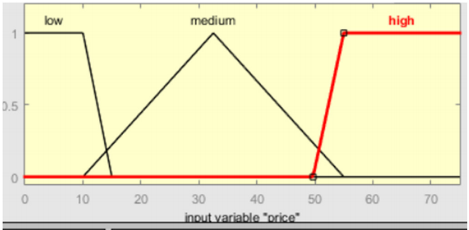
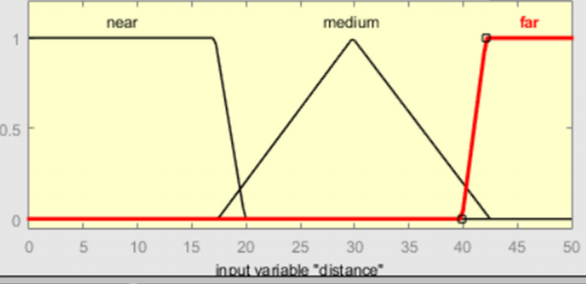
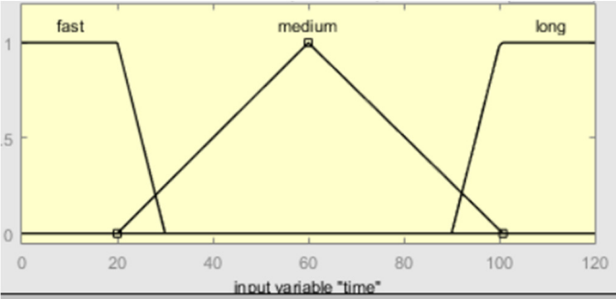
So, what is happening ?

Slide 15
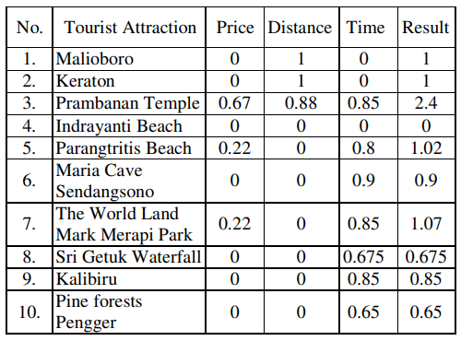
Weight of tourism attraction | Result
USER I/P :
Cost : M
Distance : N
Price : M
This is the result/recommendations obtained
with the help of Mamdani Fuzzy logic

Slide 16
Route Recommendation
Algorithm : Floyd Warshall Algorithm
Floyd Warshall
Recommendations
Route Recommendation
Distance
Google Map API

Slide 17
Scope [Analyze different combination and its results]
SITE RECOMENDATION
PATH RECOMENDATION
Different Fuzzy Logic algorithms

Slide 18
TOURISM
RECOMMENDATION
SYSTEM
THANK YOU
Any Questions ?
PRESENTATION BY : 202IT009 | Kodingari Rajasekhar (M.Tech)
203IT001 | Shankaranarayan N (M.Tech Research IT)
202IT028 | Sibangkar basumatary (M.Tech)
202IT030 | Tushar (M.Tech)
IT700 | Project Presentation 1 | 18 Dec 2020

